Slide 1



: Project 1
MusicForFood
UCB Coding Bootcamp | javascript-jockies | November 14, 2020

Slide 2
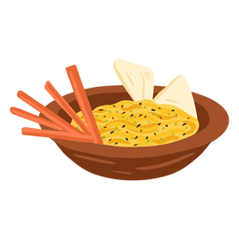


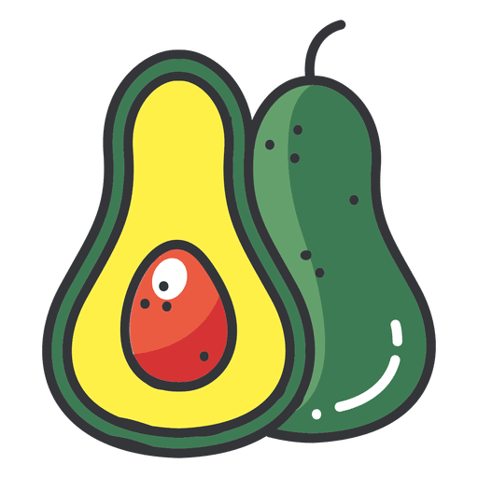

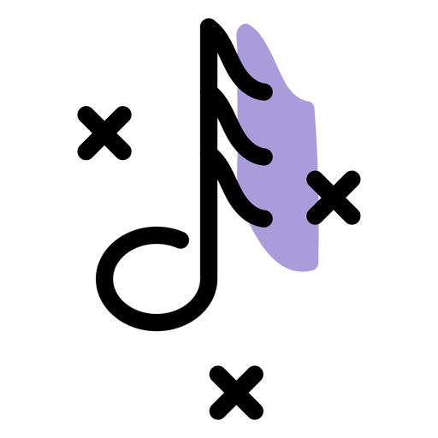
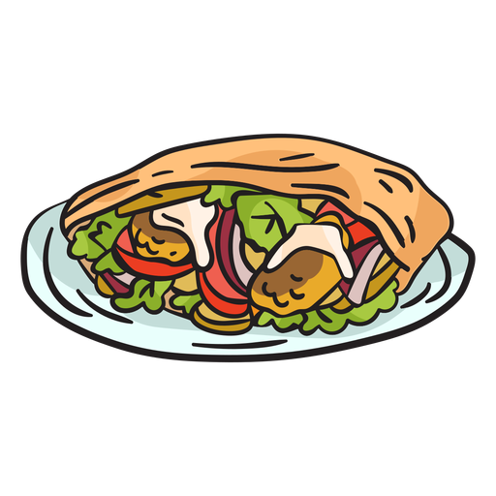

Music for food
User story
As a user I want to have the capability to select music from the same culture to pair with my food so I feel immersed in the experience all around.
Team Javascript Jockies ©2020

Slide 3

MusicForFood

Slide 4
Project overview

Slide 5

Agenda
Agenda Topics
Divide into groups
Begin researching APIs
Outline project ideas
Submit Project Proposal for Approval
Initial Design work
Team Javascript Jockies ©2020

Slide 6
Team Javascript - Jockies
__________________________________________

Slide 7




Team members
Design lead
Development lead
Product lead
Delivery lead
Geoffrey
jiang
Clinton
chunga
Christian
Suchoski
Kathleen welch
Team Javascript Jockies ©2020

Slide 8
Collaboration time
Brainstorm possible ideas
Begin API Research
Create an initial draft / sketch of the final design
Create a short 1 page proposal listing out each of the following:
Project Title
New Team Name (Javascript - Jockies)
Team Members
Project Description
Sketch of Final Product
APIs to be Used
Rough Breakdown of Tasks
Team Javascript Jockies ©2020

Slide 9
__________________________
Tools

Slide 10
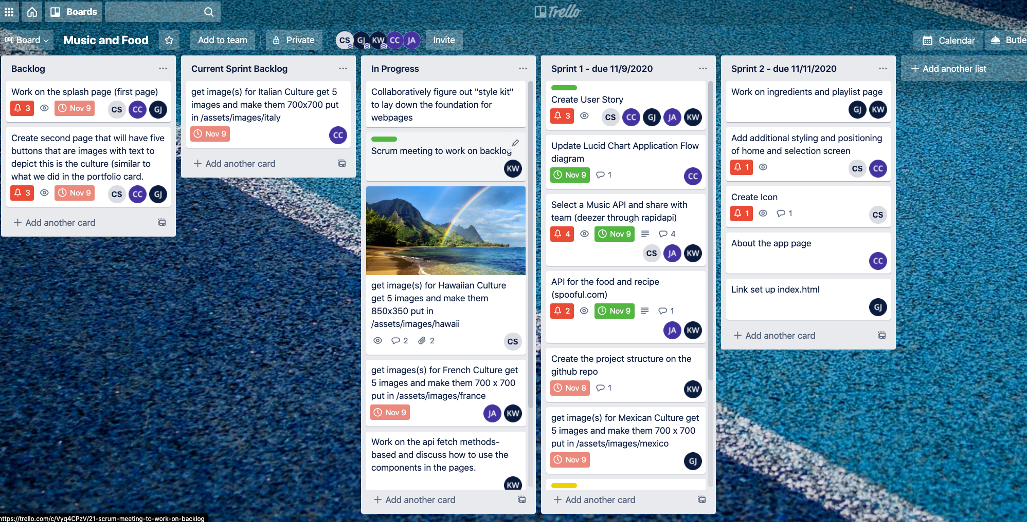
Trello
Trello is a great project management tool for creating to-do lists and communicating updates.
Team Javascript Jockies ©2020

Slide 11
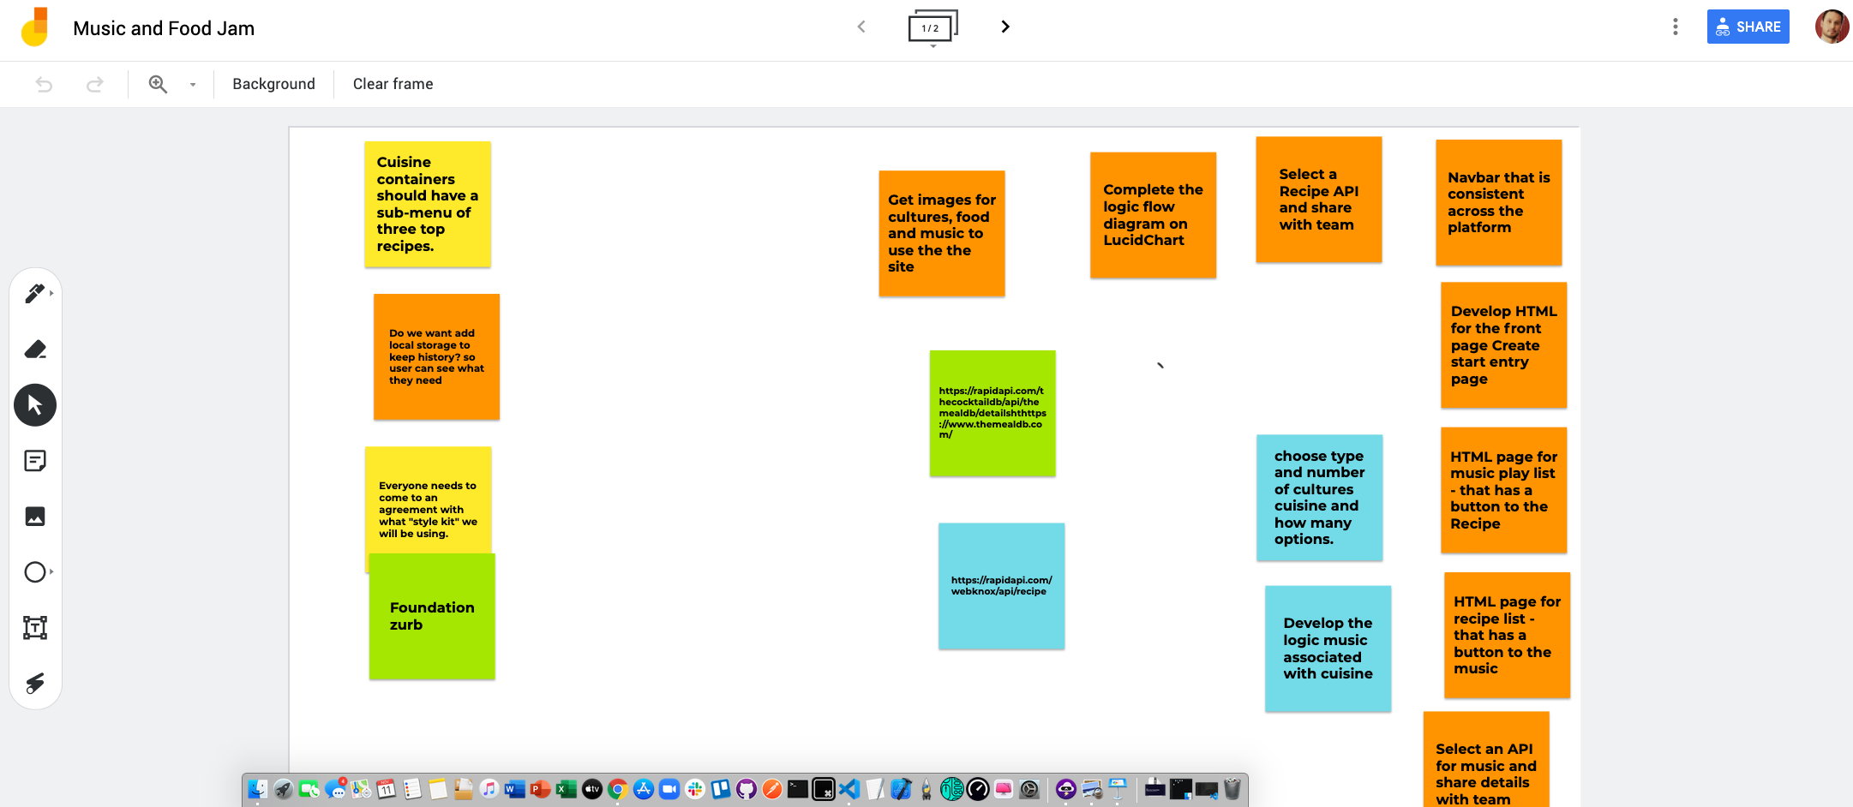
Jam board
Jam board is an interactive whiteboard system where your creative team can begin brainstorming and putting up “stickies” to create that initial spark.
Creative flow and set important task.
Team Javascript Jockies ©2020

Slide 12
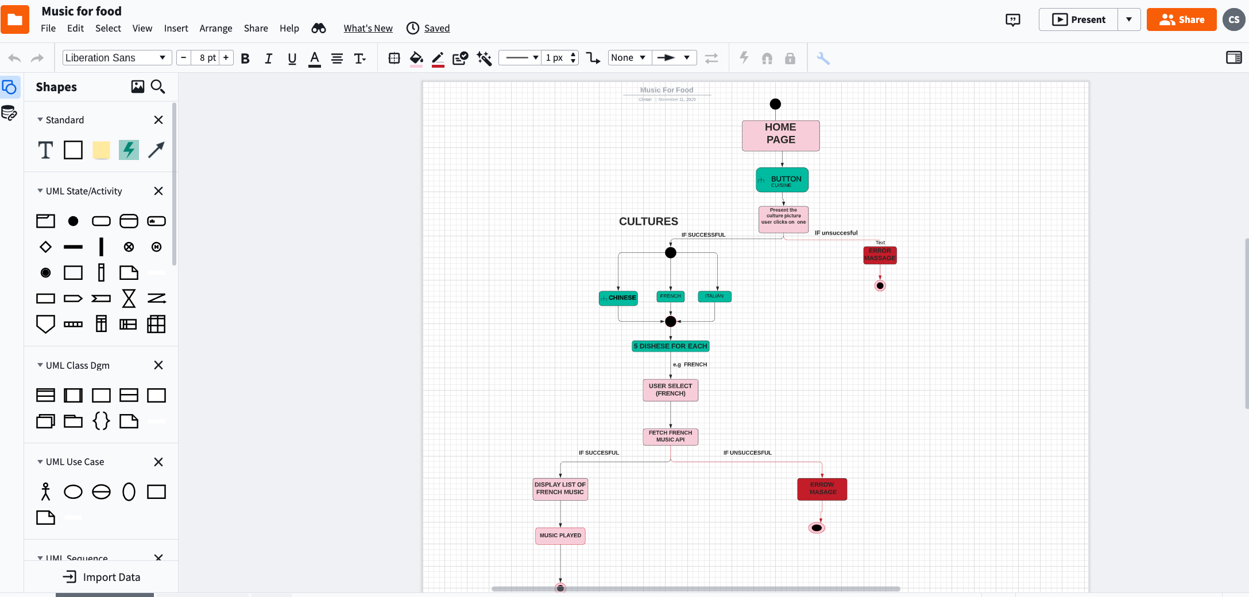
Lucid Chart
Create professional flowcharts, process maps, UML models, org charts, and ER diagrams ...
Team Javascript Jockies ©2020

Slide 13
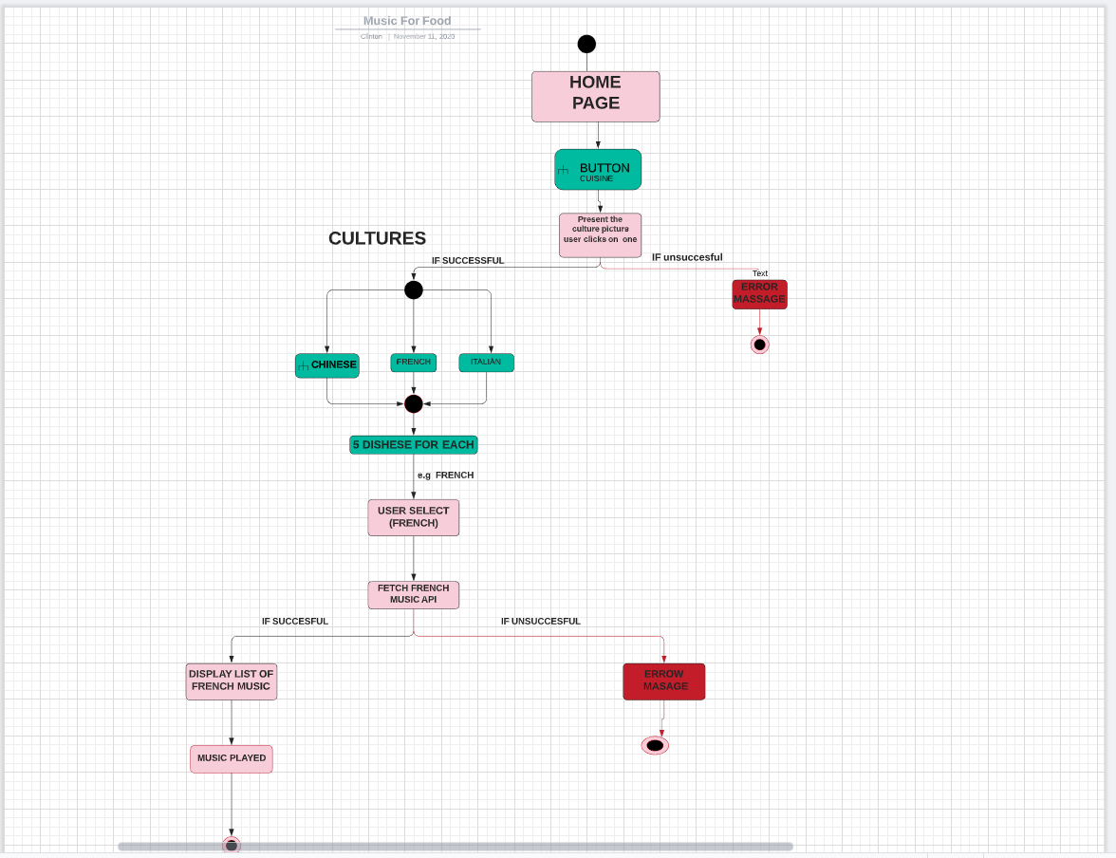

Slide 14
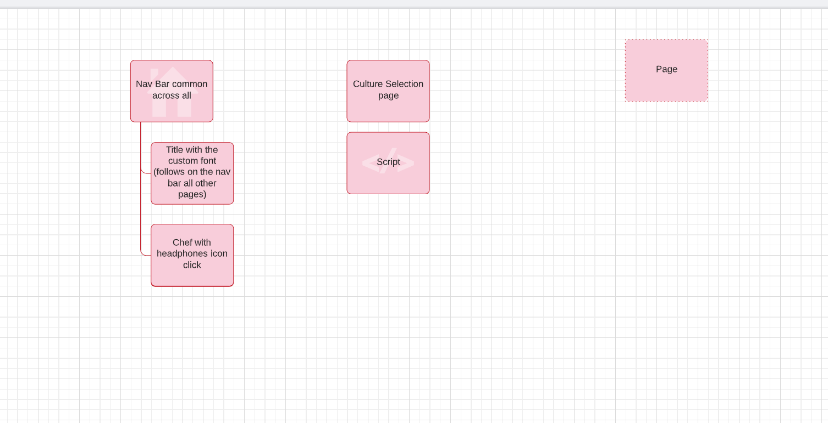

Slide 15
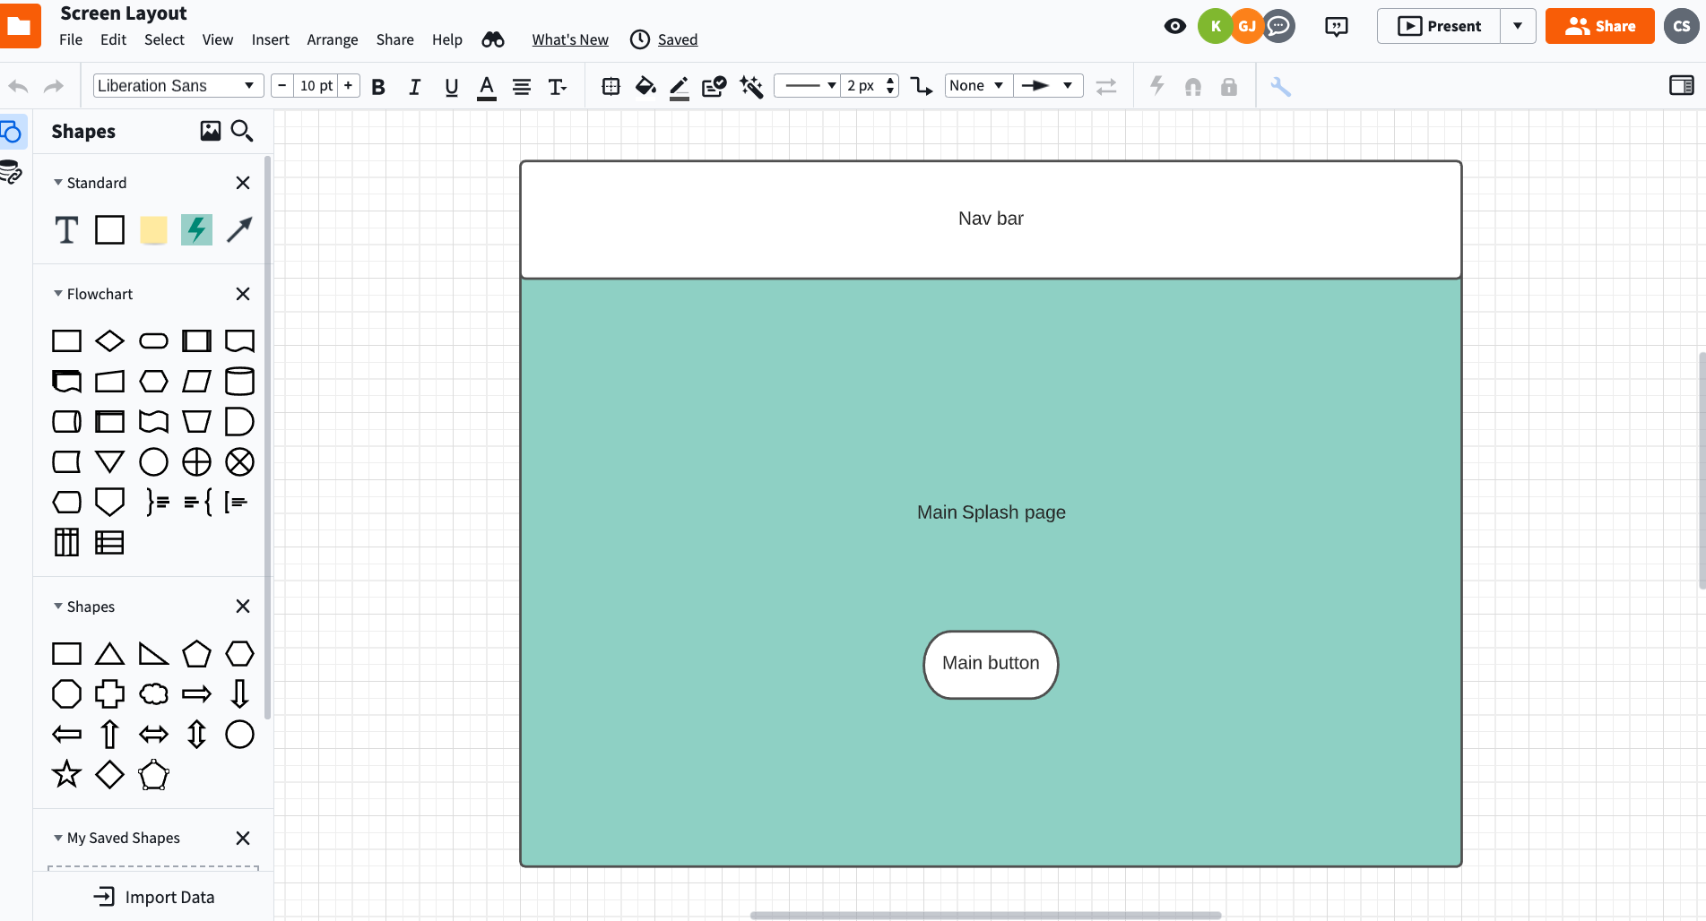

Slide 16
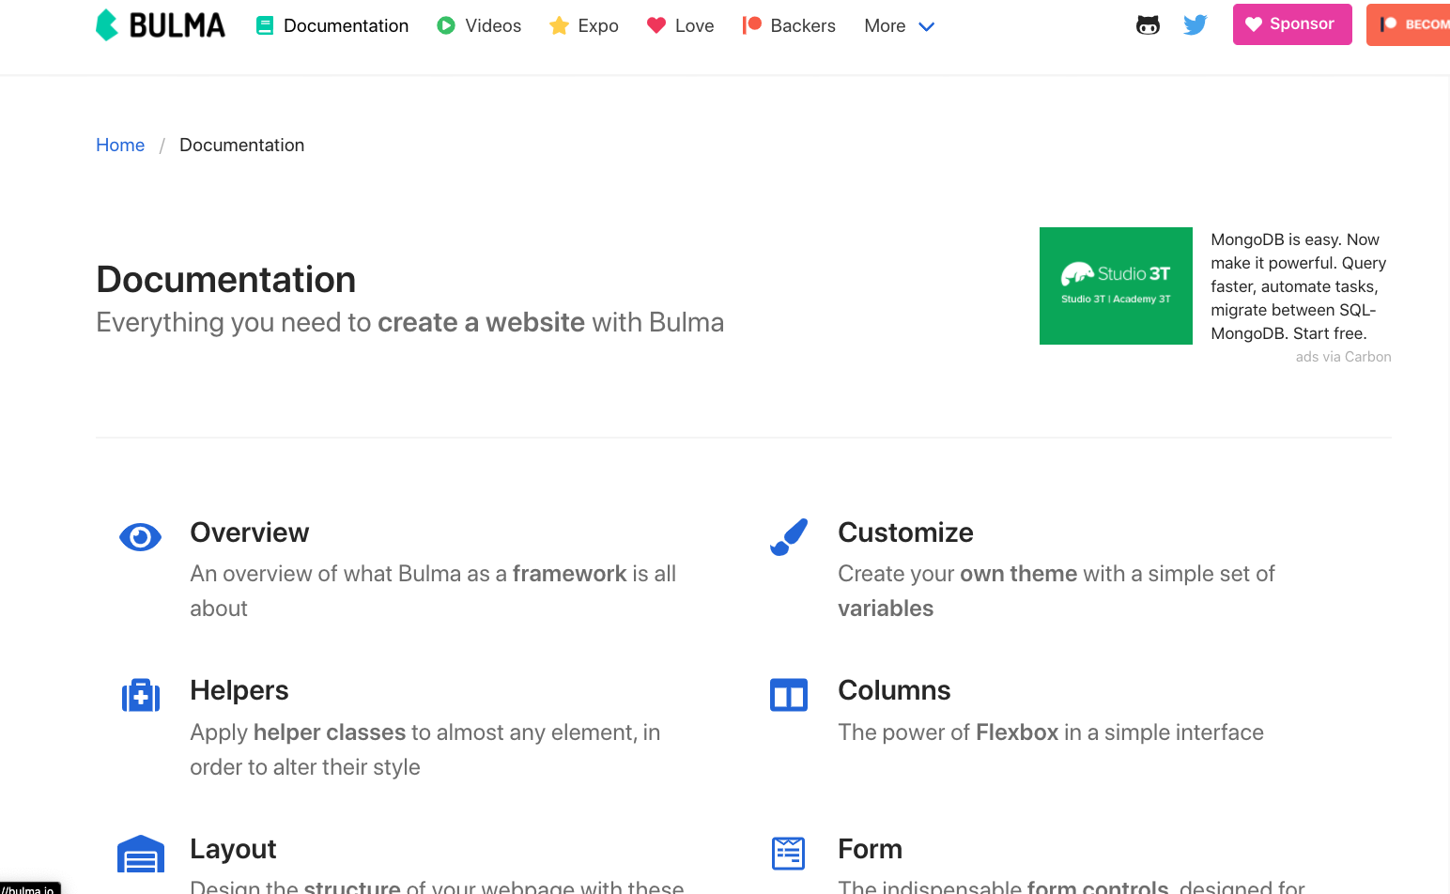
Bulma
Bulma is a free, open source CSS framework based on Flexbox and built with Sass.
Team Javascript Jockies ©2020

Slide 17
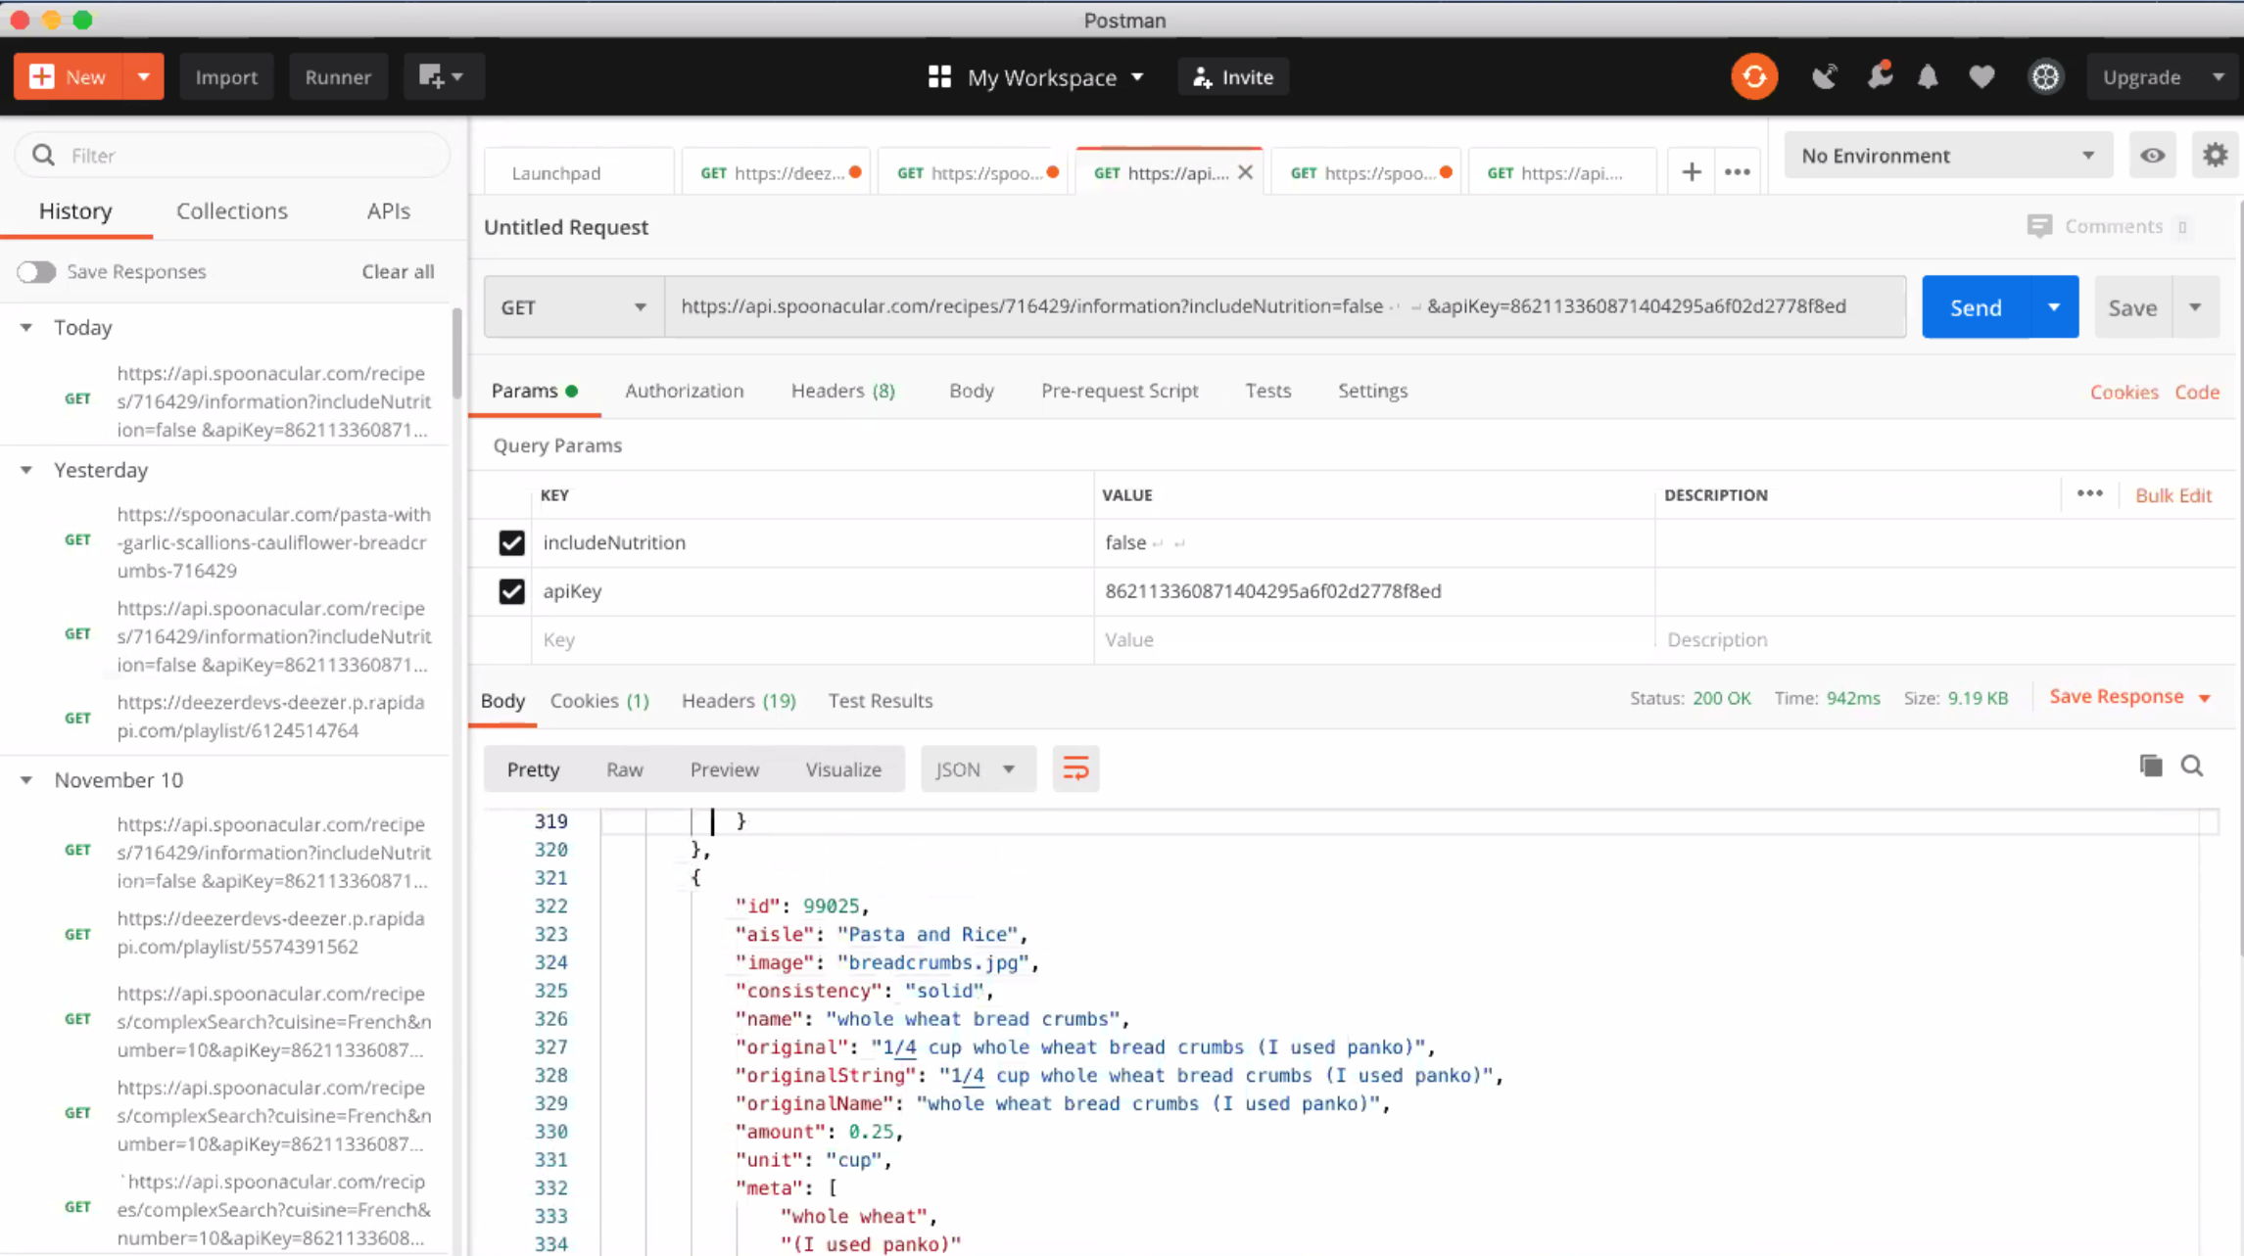
Postman
Simplify each step of building an API and streamline collaboration so you can create better APIs—faster.
Team Javascript Jockies ©2020

Slide 18
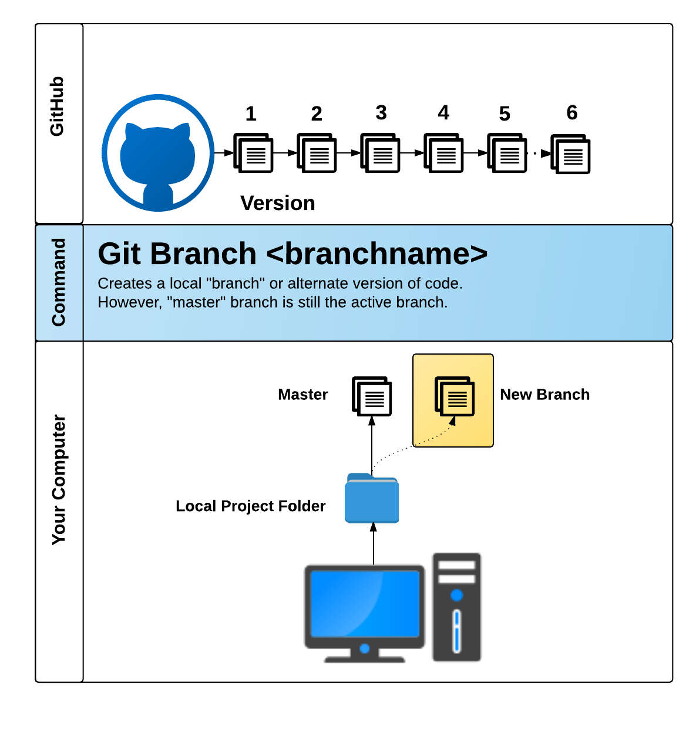
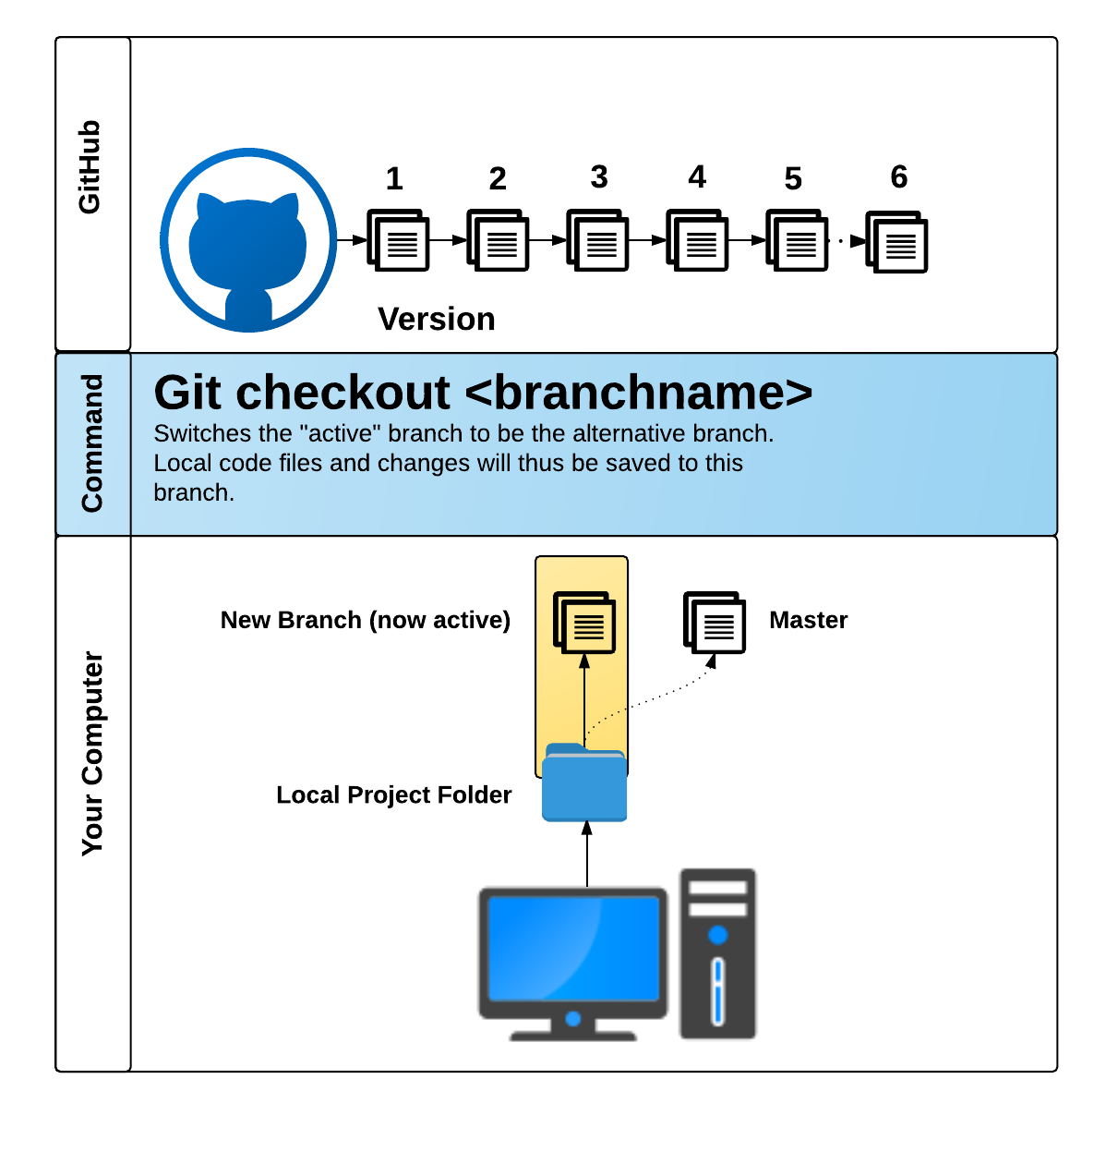
Github pull request
GitHub Pull Requests are a great way to “combine” code when multiple users are working on the same files.
Team Javascript Jockies ©2020

Slide 19
Task at hand
__________________________

Slide 20
Find the perfect api
Stick to APIs that do all of the following:
Allows CORS (i.e. Doesn’t block you from using it on your own website)
Simple or no authentication (Authenticating can be messy)
JSON response returned
Well documented
Team Javascript Jockies ©2020

Slide 21
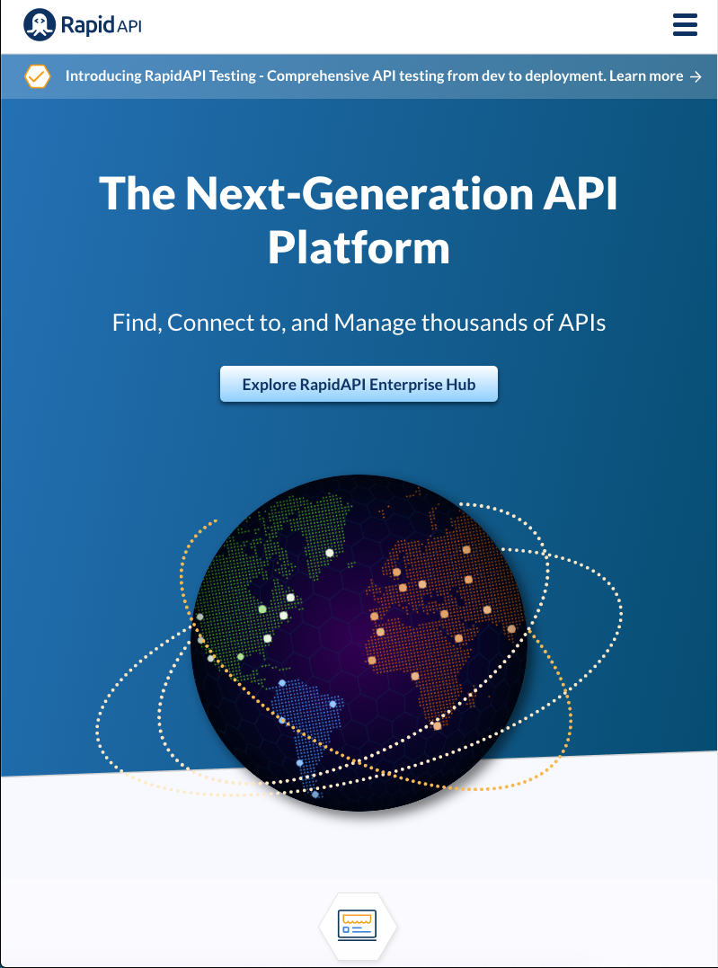
APi used
Music API: Deezer
Deezer is the No. 1 site for listening to music on demand. Discover more than 30 million tracks, create your own playlists, and share your favourite tracks.
Recipe API: Spoonacular
The spoonacular Nutrition, Recipe, and Food API allows you to access over 365,000 recipes and 86,000 food products.
Team Javascript Jockies ©2020

Slide 22
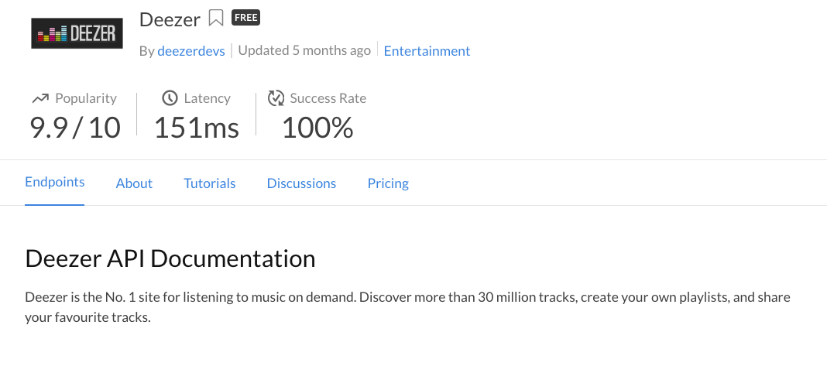
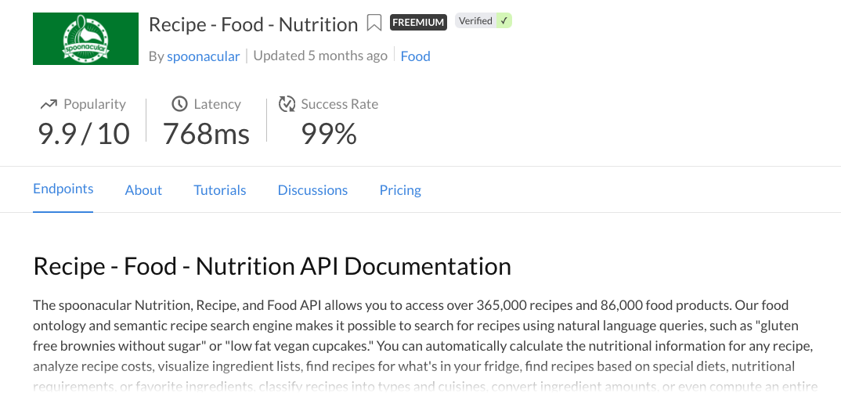

Slide 23
Concepts , design , & Functionality
______________________________________________

Slide 24
Concept
“Not Reinventing the wheel”
Group brainstorm.
Found two popular APIs.
Main focus was to have a simple MVP (Recipe/Music)
Effortless and to the point.
Searched various apps that might use our concept for “inspiration”.
Team Javascript Jockies ©2020

Slide 25
Design
Team Javascript Jockies ©2020

Slide 26
Design
Team Javascript Jockies ©2020

Slide 27
Functionality
Team Javascript Jockies ©2020

Slide 28
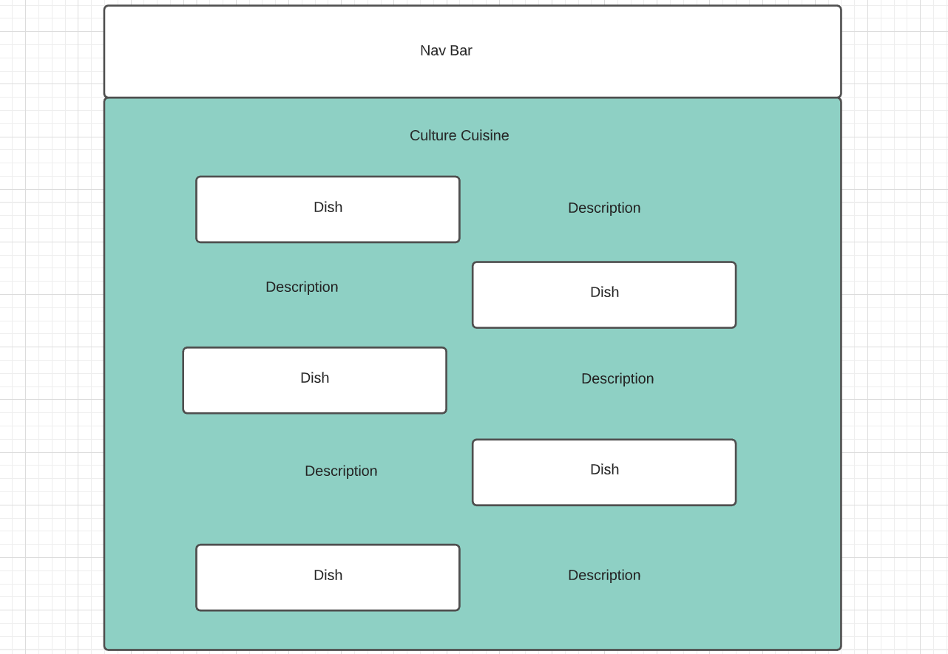
Functionality
Team Javascript Jockies ©2020

Slide 29
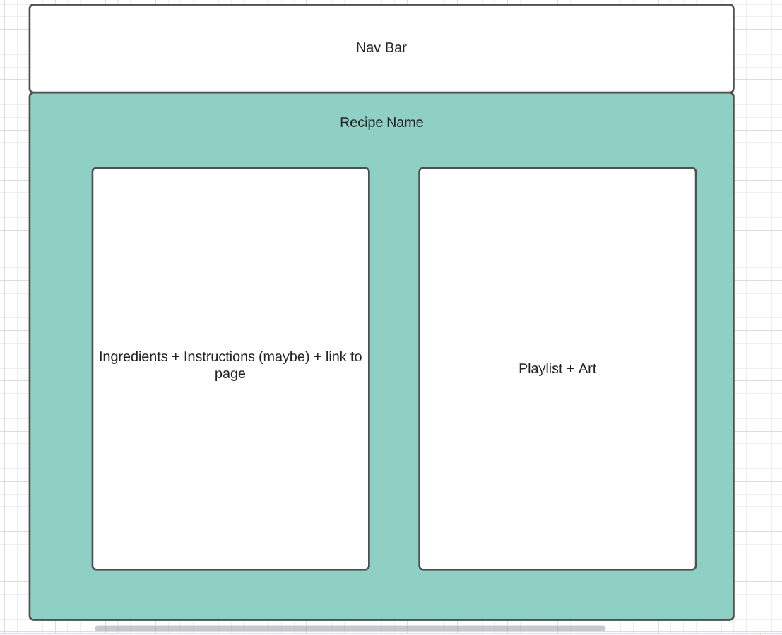
Functionality
Team Javascript Jockies ©2020

Slide 30
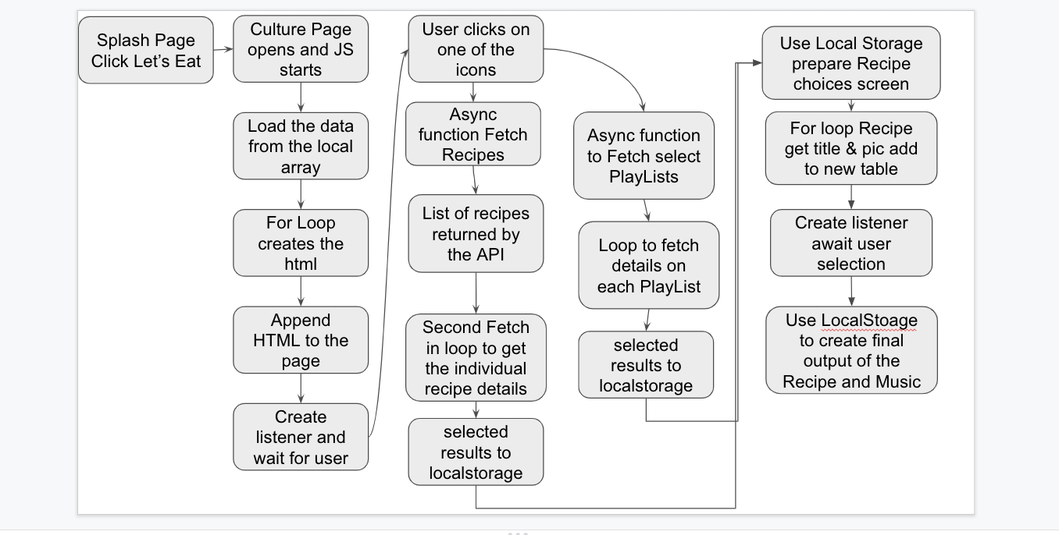
Functionality
Team Javascript Jockies ©2020

Slide 31
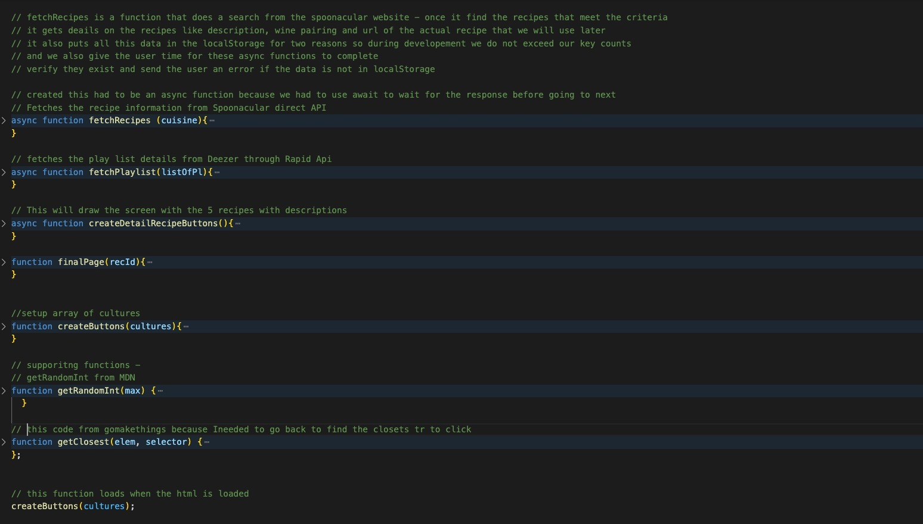
Functionality
Team Javascript Jockies ©2020

Slide 32
Functionality
https://ktywelch.github.io/MusicForFood/assets/html/first-page.html
Team Javascript Jockies ©2020

Slide 33
Future Development

Slide 34
Future Development
1. Debug some of our problems and flush out any other issues on the backend.
2. Have user be able to log in with their Deezer account thru our application.
3. Work on a native application for iOS/android.
4. Building and enhancing our UI.
(ex. one more feature we want to add is while we are waiting we would like to put in a notification or change the cursor to a spinning cursor.)
Team Javascript Jockies ©2020

